Slide 1
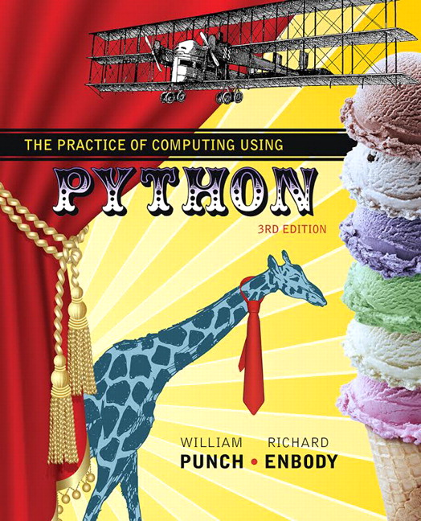
The Practice of Computing Using Python
Third Edition
Chapter 2
Control
Slides in this presentation contains hyperlinks. JAWS users should be able to get a list of links by using INSERT+F7
Copyright © 2017, 2013, 2011 Pearson Education, Inc. All Rights Reserved
Notes:
If this PowerPoint presentation contains mathematical equations, you may need to check that your computer has the following installed:
1) MathType Plugin
2) Math Player (free versions available)
3) NVDA Reader (free versions available)

Slide 2
Control, Quick Overview

Slide 3
Selection (1 of 3)
Selection is how programs make choices, and it is the process of making choices that provides a lot of the power of computing

Slide 4
Selection (2 of 3)
Figure 2.1 Sequential program flow.

Slide 5
Selection (3 of 3)
Figure 2.2 Decision making flow of control.

Slide 6
Booleans for Decisions
TABLE 2.1 Boolean operators.
< | less than
> | greater than
<= | less than or equal to
>= | greater than or equal to
== | equal to
!= | not equal to
Note that == is equality, = is assignment

Slide 7
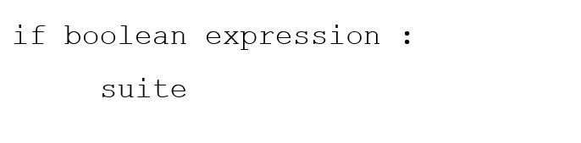
Python if statement
evaluate the boolean (True or False)
if True, execute all statements in the suite

Slide 8
Warning about Indentation
Elements of the suite must all be indented the same number of spaces/tabs
Python only recognizes suites when they are indented the same distance (standard is 4 spaces)
You must be careful to get the indentation right to get suites right.

Slide 9
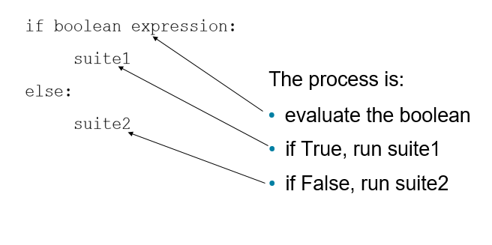
Python Selection, Round 2

Slide 10
The if-else Statement

Slide 11
Safe Lead in Basketball
Algorithm due to Bill James (www.slate.com)
under what conditions can you safely determine that a lead in a basketball game is insurmountable?

Slide 12
The Algorithm
Take the number of points one team is ahead
Subtract three
Add
point if team that is ahead has the ball, subtract
point otherwise
Square the result
If the result is greater than the number of seconds left, the lead is safe

Slide 13
Code Listing 2.3: First Cut
Problem, what if the lead is less than 0?

Slide 14
Code Listing 2.4 :Second Cut
catch the lead less than 0

Slide 15
Code Listing 2.7

Slide 16
Repetition, Quick Overview

Slide 17
Repeating Statements
Besides selecting which statements to execute, a fundamental need in a program is repetition
Repeat a set of statements under some conditions
With both selection and repetition, we have the two most necessary programming statements

Slide 18
While and For statements
The while statement is the more general repetition construct. It repeats a set of statements while some condition is True.
The for statement is useful for iteration, moving through all the elements of data structure, one at a time.

Slide 19
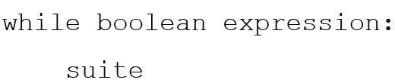
While Loop (1 of 2)
Top-tested loop (pretest)
Test the boolean before running
Test the boolean before each iteration of the loop

Slide 20
While Loop (2 of 2)
Figure 2.4 While loop

Slide 21
Repeat While the Boolean is True
While loop will repeat the statements in the suite while the boolean is True (or its Python equivalent)
If the Boolean expression never changes during the course of the loop, the loop will continue forever.

Slide 22
Code Listing 2.8

Slide 23
General approach to a while
Outside the loop, initialize the boolean
Somewhere inside the loop you perform some operation which changes the state of the program, eventually leading to a False boolean and exiting the loop
Have to have both!

Slide 24
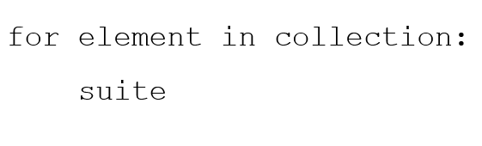
for and iteration (1 of 2)
One of Python's strength's is it's rich set of built-in data structures
The for statement iterates through each element of a collection (list, etc.)

Slide 25
for and iteration (2 of 2)
FIGURE 2.5 Operation of a for loop.

Slide 26
Perfect Number Example

Slide 27
A Perfect Number
Numbers and their factors were mysterious to the greeks and early mathematicians
They were curious about the properties of numbers as they held some significance
A perfect number is a number whose sum of factors (excluding the number) equals the number
First perfect number is: 6 (1+2+3)

Slide 28
Abundant, Deficient
Abundant numbers summed to more than the number.
12: 1+2+3+4+6 =16
Deficient numbers summed to less than the number.
13: 1

Slide 29
Design
Prompt for a number
For the number, collect all the factors
Once collected, sum up the factors
Compare the sum and the number and respond accordingly

Slide 30
Code Listing 2.10 : Check Perfection

Slide 31
Code Listing 2.11 : Sum Divisors

Slide 32
Improving the Perfect Number Program
Work with a range of numbers
For each number in the range of numbers:
Collect all the factors
Once collected, sum up the factors
Compare the sum and the number and respond accordingly
Print a summary

Slide 33
Code Listing 2.13 : Examine a Range of Numbers

Slide 34
Code Listing 2.15 : Classify Range of Numbers

Slide 35
Control in Depth

Slide 36
Boolean Expressions
George Boole's (mid-1800's) mathematics of logical expressions
Boolean expressions (conditions) have a value of True or False
Conditions are the basis of choices in a computer, and, hence, are the basis of the appearance of intelligence in them.

Slide 37
What is True, and What is False
true: any nonzero number or nonempty object. 1, 100, "hello", [a,b]
false: a zero number or empty object. 0, "",[ ]
Special values called True and False, which are just subs for 1 and 0. However, they print nicely (True or False)
Also a special value, None, less than everything and equal to nothing

Slide 38
Boolean Expression
Every boolean expression has the form:
Expression boolean Operator expression
The result of evaluating something like the above is also just true or false.
However, remember what constitutes true or false in Python!

Slide 39
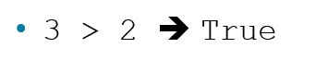
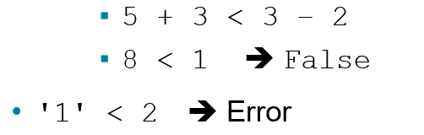
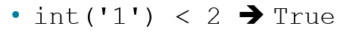
Relational Operators
Relational Operators have low preference
Can only compare like types
Like types, regular compare

Slide 40
What Does Equality Mean? (1 of 2)
Two senses of equality
Two variables refer to different objects, each object representing the same value
Two variables refer to the same object. The id() function used for this.

Slide 41
What Does Equality Mean? (2 of 2)
Figure 2.6 What is equality?

Slide 42
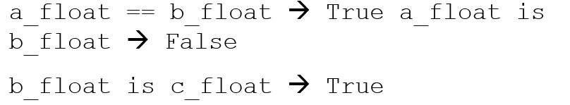
Equal vs. Same
== compares values of two variable's objects, do they represent the same value
Is operator determines if two variables are associated with the same value
From the figure:

Slide 43
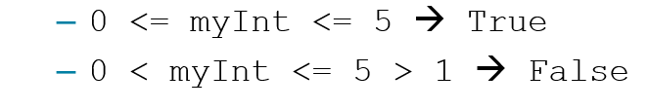
Chained Comparisons
In Python, chained comparisons work just like you would expect in a mathematical expression:
Given myInt has the value 5

Slide 44
Pitfall
Floating point arithmetic is approximate!

Slide 45
Compare Using “Close Enough”
Establish a level of “close enough” for equality

Slide 46
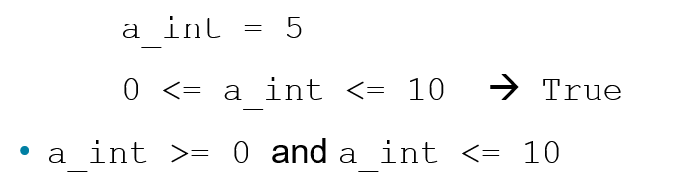
Compound Expressions
Python allows bracketing of a value between two Booleans, as in math
and, or, not are the three Boolean operators in Python

Slide 47
Truth Tables (1 of 5)
p | Q | not p | p and q | p or q
True | True | Blank | Blank | Blank
True | False | Blank | Blank | Blank
False | True | Blank | Blank | Blank
False | False | Blank | Blank | Blank

Slide 48
Truth Tables (2 of 5)
p | q | not p | p and q | p or q
True | True | False | Blank | Blank
True | False | False | Blank | Blank
False | True | True | Blank | Blank
False | False | True | Blank | Blank

Slide 49
Truth Tables (3 of 5)
p | q | not p | p and q | p or q
True | True | Blank | True | Blank
True | False | Blank | False | Blank
False | True | Blank | False | Blank
False | False | Blank | False | Blank

Slide 50
Truth Tables (4 of 5)
p | q | not p | p and q | p or q
True | True | Blank | Blank | True
True | False | Blank | Blank | True
False | True | Blank | Blank | True
False | False | Blank | Blank | False

Slide 51
Truth Tables (5 of 5)
p | q | not p | p and q | p or q
True | True | False | True | True
True | False | False | False | True
False | True | True | False | True
p | q | not p | p and q | p or q

Slide 52
Compound Evaluation
Logically 0 < a_int < 3 is actually (0 < a_int) and (a_int < 3)
Evaluate using a_int with a value of 5: (0< a_int) and (a_int < 3)
Parenthesis first: (True) and (False)
Final value: False
(Note: parenthesis are not necessary in this case.)

Slide 53
Precedence and Associativity (1 of 2)
Relational operators have precedence and associativity just like numerical operators.

Slide 54
Precedence and Associativity (2 of 2)
Table 2.2 Precedence of relational and arithmetic operators: highest to lowest.
Operator | Description
() | Parenthesis (grouping)
** | Exponentiation
+x, −x | Positive, Negative
*,/,% | Multiplication, Division, Remainder
+,− | Addition, Subtraction
<, <=, >, >=,! =, == | Comparisons
not x | Boolean NOT
and | Boolean AND
or | Boolean OR

Slide 55
Boolean Operators versus Relationals
Relational operations always return True or False
Boolean operators (and,or) are different in that:
They can return values (that represent True or False)
They have short circuiting

Slide 56
Remember!
0, '',[ ] or other “empty” objects are equivalent to False
anything else is equivalent to True

Slide 57
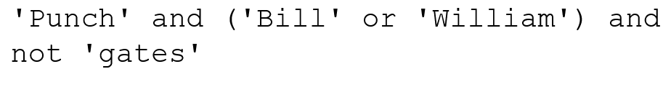
Ego Search on Google (1 of 2)
Google search uses Booleans
by default, all terms are and'ed together
you can specify or (using OR)
you can specify not (using -)
Example is:

Slide 58
Ego Search on Google (2 of 2)
Figure 2.7 The Google advanced search page.

Slide 59
More on Assignments

Slide 60
Remember Assignments?
Format: lhs = rhs
Behavior:
expression in the rhs is evaluated producing a value
the value produced is placed in the location indicated on the lhs

Slide 61
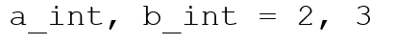
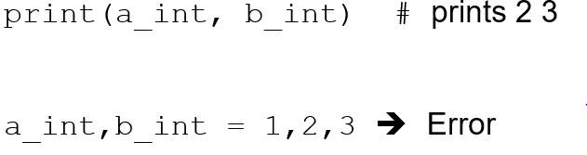
Can do Multiple Assignments
first on right assigned to first on left, second on right assigned to second on left
counts on lhs and rhs must match

Slide 62
Traditional Swap
Initial values: a_int= 2, b_int = 3
Behavior: swap values of X and Y
Note: a_int = b_int
a_int = b_int doesn't work (why?)
introduce extra variable temp
temp = a_int # save a_int value in temp
a_int = b_int # assign a_int value to b_int
b_int = temp # assign temp value to b_int

Slide 63
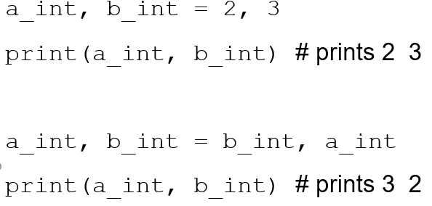
Swap Using Multiple Assignment
remember, evaluate all the values on the rhs first, then assign to variables on the lhs

Slide 64
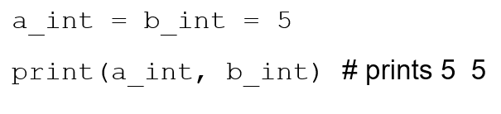
Chaining for Assignment
Unlike other operations which chain left to right, assignment chains right to left

Slide 65
More Control: Selection

Slide 66
Compound Statements
Compound statements involve a set of statements being used as a group
Most compound statements have:
a header, ending with a : (colon)
a suite of statements to be executed
if, for, while are examples of compound statements

Slide 67
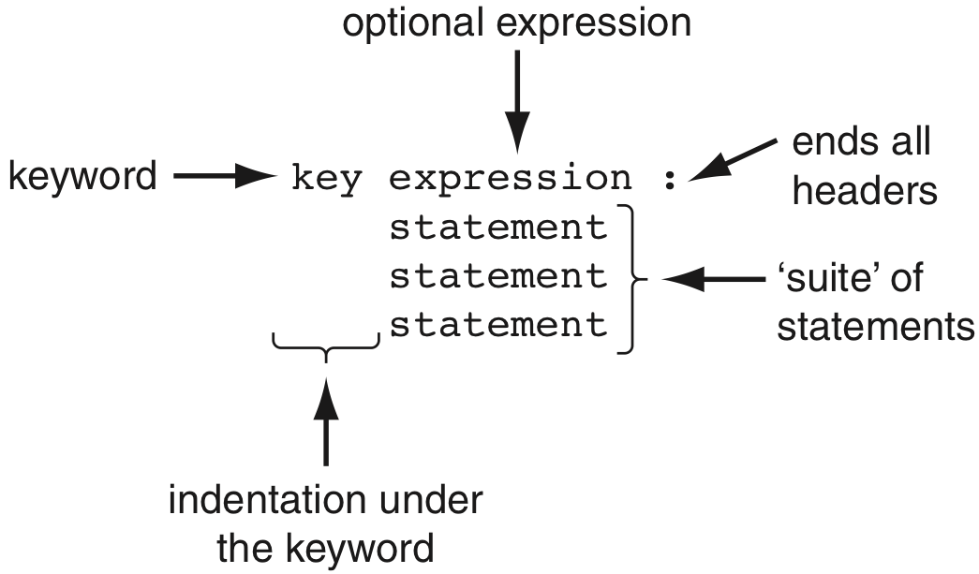
General Format, Suites

Slide 68
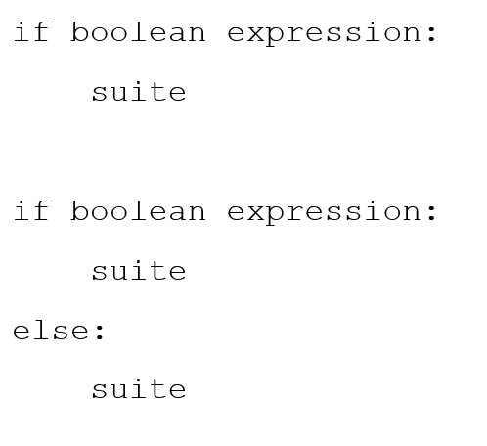
Have Seen 2 Forms of Selection

Slide 69
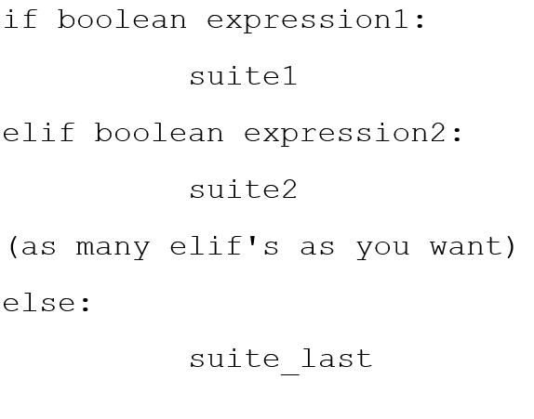
Python Selection, Round 3

Slide 70
if, elif, else, The Process
Evaluate boolean expressions until:
The boolean expression returns true
None of the boolean expressions return true
If a boolean returns true, run the corresponding suite. Skip the rest of the if
If no boolean returns true, run the else suite, the default suite

Slide 71
Code Listing 2.16 : Using elif
What happens if elif are replaced by if?

Slide 72
Code Listing 2.19 : Updated Perfect Number classification

Slide 73
More Control: Repetition

Slide 74
Developing a While Loop
Working with the loop control variable:
Initialize the variable, typically outside of the loop and before the loop begins.
The condition statement of the while loop involves a Boolean using the variable.
Modify the value of the control variable during the course of the loop

Slide 75
Issues:
Loop never starts:
The control variable is not initialized as you thought (or perhaps you don't always want it to start)
Loop never ends:
The control variable is not modified during the loop (or not modified in a way to make the Boolean come out False)

Slide 76
While Loop, Round Two
while loop, oddly, can have an associated else suite
else suite is executed when the loop finishes under normal conditions
Basically the last thing the loop does as it exits

Slide 77
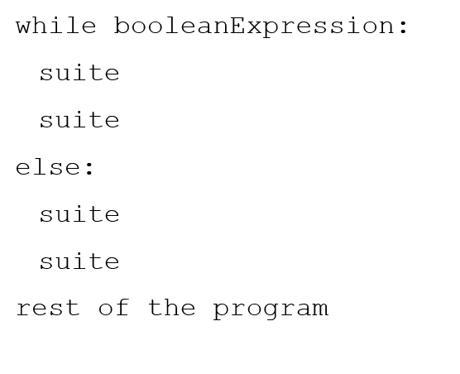
while With else (1 of 2)

Slide 78
while With else (2 of 2)

Slide 79
Break Statement
A break statement in a loop, if executed, exits the loop
It exists immediately, skipping whatever remains of the loop as well as the else statement (if it exists) of the loop

Slide 80
Code Listing 2.20 : Loop, Hi Lo Game

Slide 81
Continue Statement
A continue statement, if executed in a loop, means to immediately jump back to the top of the loop and re-evaluate the conditional
Any remaining parts of the loop are skipped for the one iteration when the continue was exectued

Slide 82
Code Listing 2.21 : Part of the Guessing Numbers Program

Slide 83
Change in Control : Break and Continue
While loops are easiest read when the conditions of exit are clear
Excessive use of continue and break within a loop suite make it more difficult to decide when the loop will exit and what parts of the suite will be executed each loop.
Use them judiciously.

Slide 84
While Overview
while test1:
statement_list_1
if test2: break # Exit loop now; skip else
if test3: continue # Go to top of loop now
# more statements
else:
statement_list_2 # If we didn't hit a 'break'
# 'break' or 'continue' lines can appear anywhere

Slide 85
Range and for loop

Slide 86
Range Function
The range function represents a sequence of integers
The range function takes 3 arguments:
The beginning of the range. Assumed to be 0 if not provided
The end of the range, but not inclusive (up to but not including the number). Required
The step of the range. Assumed to be 1 if not provided
If only one arg provided, assumed to be the end value

Slide 87
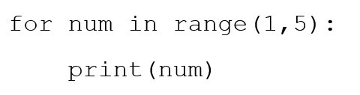
Iterating Through the Sequence
Range represents the sequence 1, 2, 3, 4
For loop assigns num to each of the values in the sequence, one at a time, in sequence
Prints each number (one number per line)

Slide 88
Range Generates on Demand
Range generates its values on demand

Slide 89
Hailstone example

Slide 90
Collatz
The Collatz sequence is a simple algorithm applied to any positive integer
In general, by applying this algorithm to your starting number you generate a sequence of other positive numbers, ending at 1
Unproven whether every number ends in 1 (though strong evidence exists)

Slide 91
Algorithm
While the number does not equal one
If the number is odd, multiply by 3 and add 1
If the number is even, divide by 2
Use the new number and reapply the algorithm

Slide 92
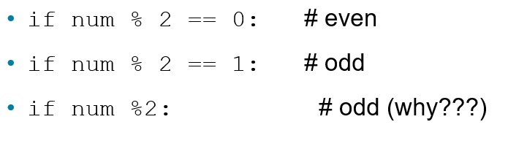
Even and Odd
Use the remainder operator

Slide 93
Code Listing 2.25 : Hailstone Sequence, Loop

Slide 94
The Rules
Think before you program!
A program is a human-readable essay on problem solving that also happens to execute on a computer.
The best way to improve your programming and problem solving skills is to practice!
A foolish consistency is the hobgoblin of little minds
Test your code, often and thoroughly

Slide 95
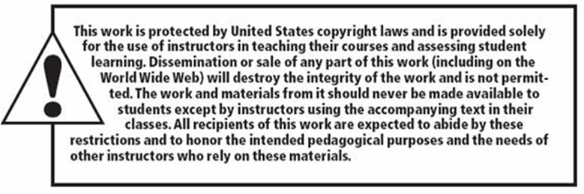
Copyright

